Slide 1
8/25 Class Objective
You will gain an understanding of the terms economics, resources, scarcity, and opportunity cost. You will also read a portion of chapter 1 and create a graphic organizer for the 7 principles of economics.
Agenda:
  Introduction to Economics Power Point
  7 Principles of Economics Graphic Organizer using the textbook

Slide 2

What is Economics?
Economics is called by many as the science of choice
  What does that mean?
  It means people have choices on things such as…
    How to spend their time
    How to spend their money
Decisions you make everyday is economics!
  Coming to class
  What food you buy

Slide 3
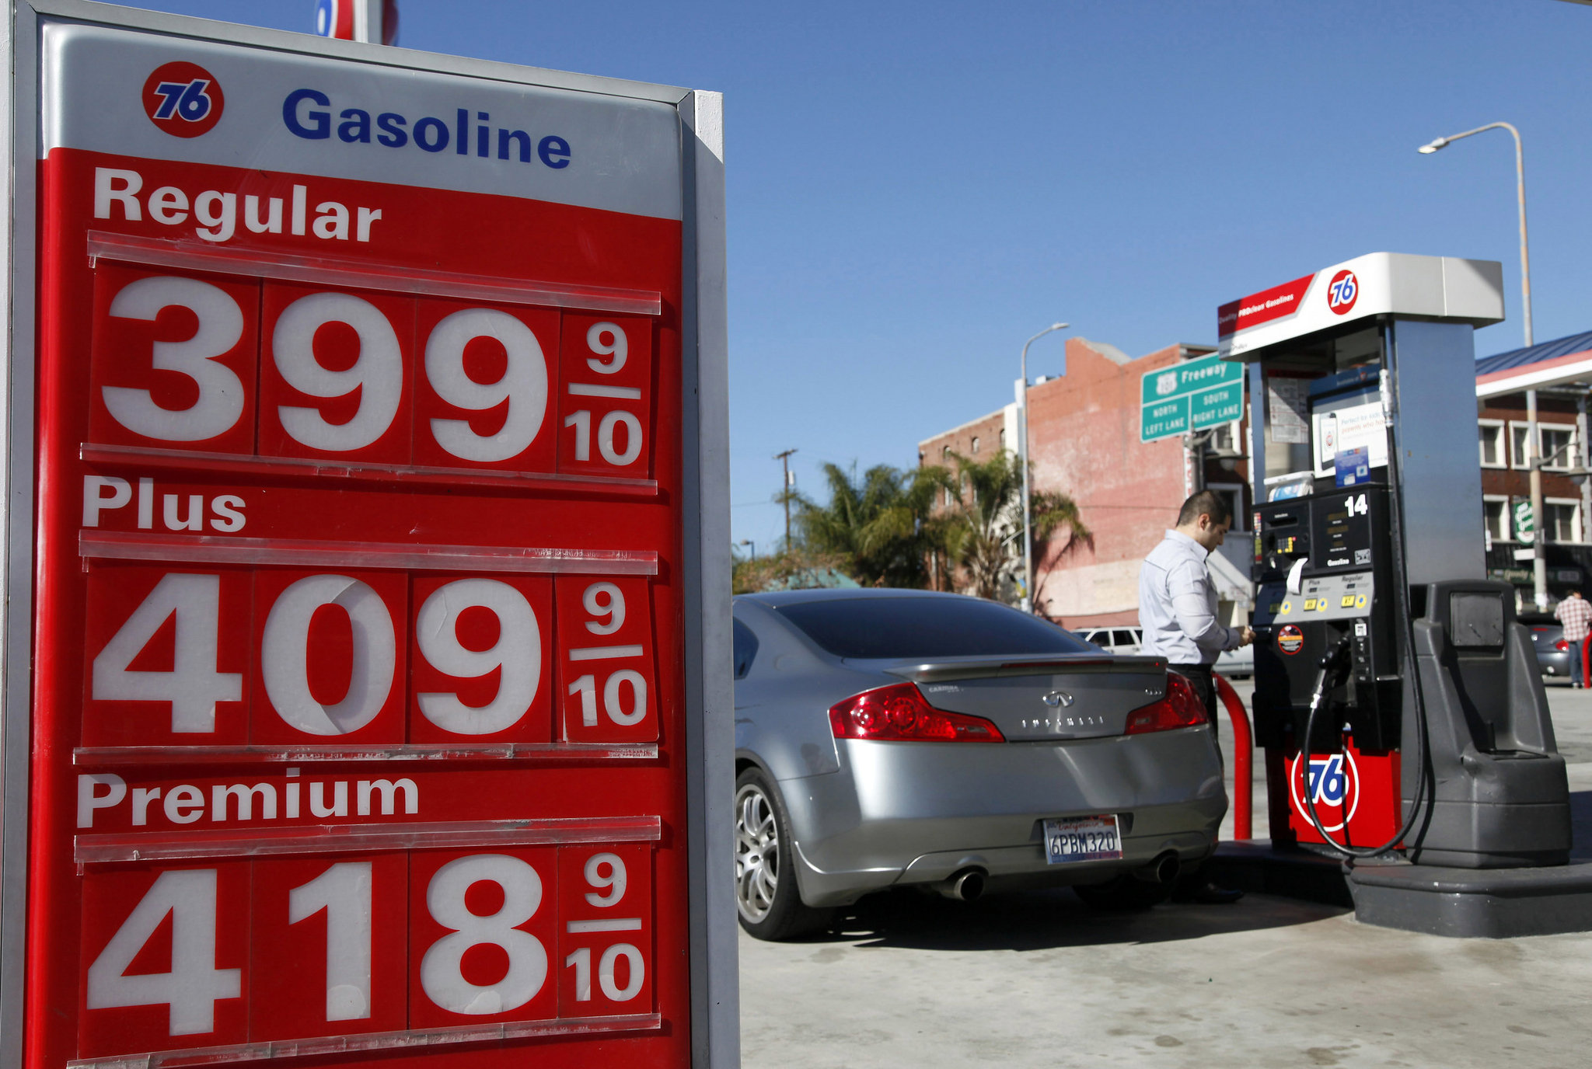
What are Resources?
In Economics we study how people use resources to satisfy their wants and needs.
  What are the differences between WANTS and NEEDS?
A resource is anything used to produce an economic good or service to satisfy a want or need.

Slide 4
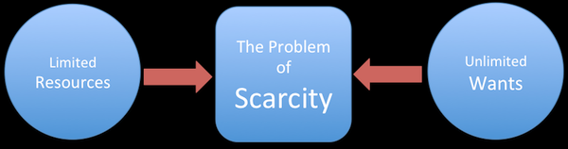
What is Scarcity?
Scarcity is the basic problem that all humans face.
  Human wants and needs are LIMITLESS, but the resources we have to obtain those wants and needs are LIMITED.
    Resources = Limited
    Human: Wants = Limitless
  So… economics is the study of how we make choices to best satisfy our wants in a world of SCARCE resources.

Slide 5

What is Opportunity Cost?
Any time we make a decision there is always a cost.
  Cost can sometimes be…
    Money
    Time
    Resources
Opportunity Cost
  The value of the next best alternative that you could have chosen.
    What examples can we come up with?

Slide 6
Thinking back…
In our last class, we looked at allocating patient hours to a dialysis machine.
  In your notebooks answer these questions using full sentences:
    What choices did you have to make?
    What were the resources and were they limited?
    How did the economic idea of scarcity affect your decision making?
    What were the opportunity costs of the choices you made?

Slide 7
7 Principles
Using the textbook pages (6-10)
Create a graphic organizer in your notebook for the 7 principles of economics.

